Slide 1
Durable Functions
.NET Developers Association
Aug 7th, 2018
Katy Shimizu

Slide 2
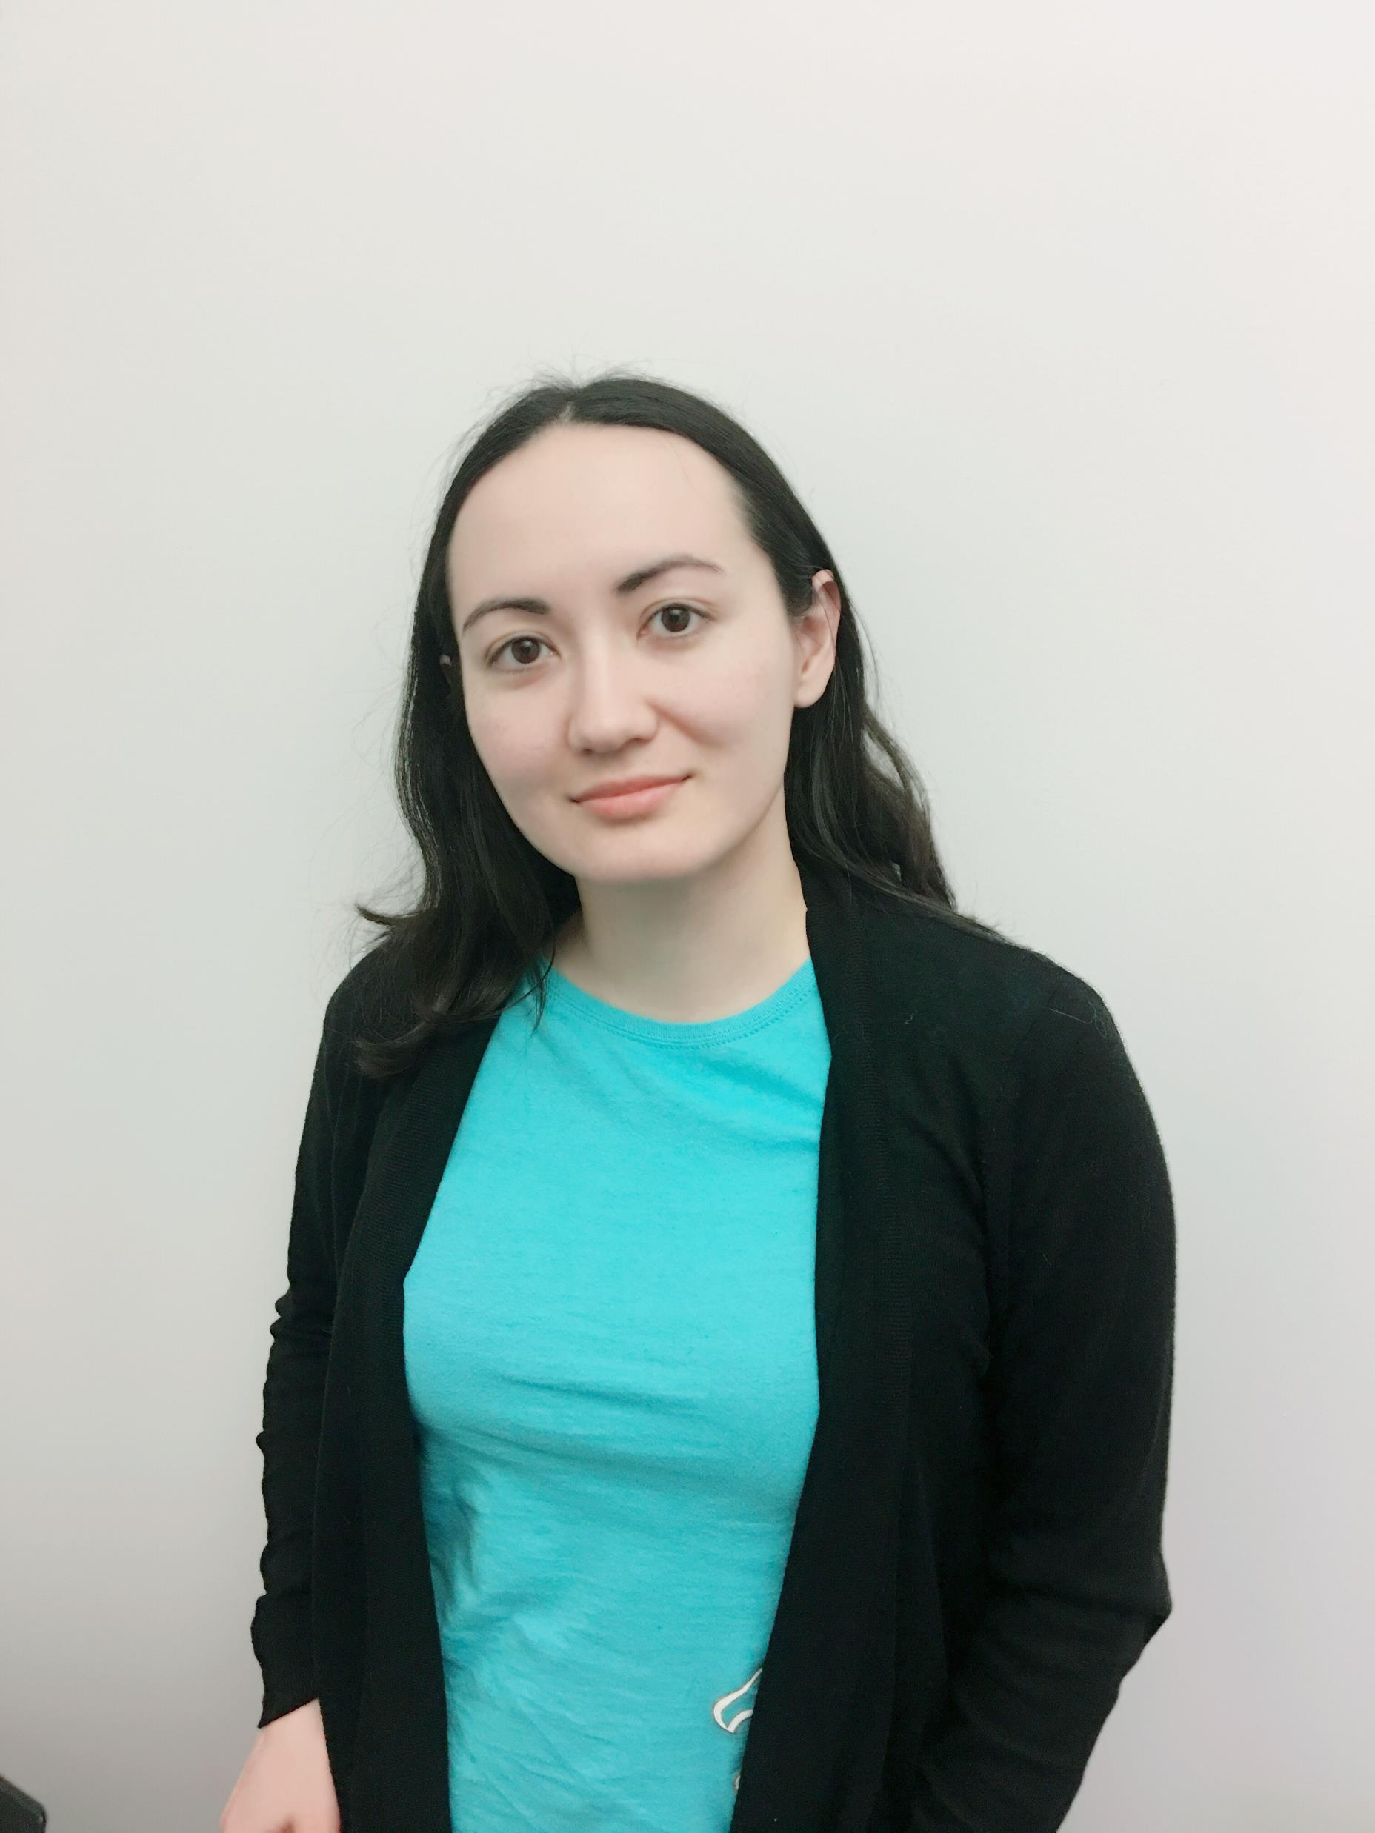
Katy Shimizu Software Engineer II @ Microsoft App Service Azure Functions Durable Functions Durable.JS @kashimizMSFT katy.shimizu@microsoft.com

Slide 3
The “Evolution” of Application Platforms
On-Premises
IaaS
PaaS
Serverless

Slide 4
What is serverless?
$
Abstraction of servers
Event-driven/ instant scale
Micro-billing
Notes:
Abstraction of servers, infrastructure and configuration of operating system
Event-driven scale
Sub-second billing
Stateless
Serverless compute is a fully managed service. Some refer to it as Functions as a Service
OS and Framework patching is performed for you
There is zero administrative tasks and no need to manage any infrastructure
You just deploy your code (function) and it runs
Your code runs within seconds and for very short period of time
Serverless compute scales quickly (almost instantly) and vastly
Automatically scales within seconds
No scale configuration is required (there is no way to configure scale or limits)
Scales to match any given workload. Scales from zero to handle tens of thousands concurrent functions invocations within seconds
Pay only for the time your code is running
Serverless compute reacts to events
React, in near real-time, to events and triggers
Triggered by virtually any event from Azure service or 3rd party services
Setup time, provisioning is long & costly

Slide 5
Serverless benefits
DevOps Productivity
Focus on business logic
Faster time to market
Notes:
“Pinnacle of PaaS compute”
Not just hardware “servers”, but software servers are also managed for you
Focus on business logic, not solving technical problems not core to business
Writing business logic from the first line of code
Lower effort to get started makes it easier to experiment (bots, etc.)
Benefits of “Serverless”

Slide 6



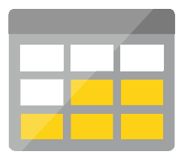
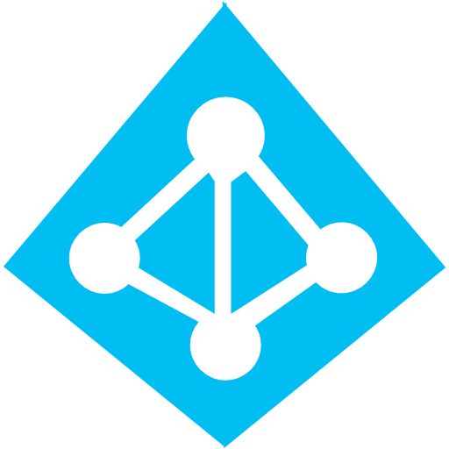



Serverless application platform components
Development
Platform
IDE support
Functions
Logic apps
Event Grid
Integrated DevOps
Developer productivity
Visual designer
Manage all events in one place
Triggers and Bindings
100+ connectors
Near real-time delivery
Local development
Flexible deployment options
Functions orchestration
Broad coverage
Monitoring
Database
Storage
Security & Access Control
IoT
Analytics
Intelligence
Visual Debug History
Notes:
Lets talk about what really makes up MSFT’s Serverless platform: At the center of the Serverless platform, is our compute offerings: Azure Functions and Azure Logic Apps. Azure Functions is an event based Serverless compute experience that helps you accelerate your development. Logic Apps is a powerful workflow and orchestration tool. It enables building a Serverless app in minutes – by orchestrating multiple functions using a visual workflow tool.
Say you have your apps up and running using Serverless. Congratulations! You now need to collect intelligence from different apps across platforms to take actions upon. There are a few essential components which we think are core to building Serverless applications are:
Data/ Storage –Functions has triggers and bindings with Azure document DB and Azure Blob storage
** Triggers: Triggers are event responses used to trigger your custom code. They allow you to respond to events across the Azure platform or on premise.
** Bindings: Bindings represent the necessary meta data used to connect your code to the desired trigger or associated input or output data.
Messaging such as queues and topics using Azure Service Bus and Azure Event Hubs
Integration – that includes core LOB apps and SaaS apps integration via Azure Logic Apps.
Intelligence on data and sentiment/ predictive analysis using Cognitive services and Machine learning
Conversation as a service – how do we equip developers to build apps that offer an end-to-end experience for their end users – Azure Bot Service offers a Serverless interactive bot experience.
More, developers are spending more time writing code that allows them to add huge business impact with Serverless. MSFT offers numerous development tools such as IDE Support for Visual Studio in functions and Logic Apps, enables local development (vs web browser coding environment), visual debugging capability, all with your tools of choice.
Lastly, I also want to highlight top scenarios and use cases for Serverless:
Real-time Stream analytics: Customers can use Functions to feed real-time streams of data from application tracking into structured data and store it in SQL online.
SaaS event processing: Customers can use Functions and Logic Apps to analyze data from an excel file in Onedrive and perform validation, filtration, sorting and convert data into consumable business charts
Web app architecture: Used a lot in creating targeted marketing collaterals – when a customer clicks on a webpage, it triggers a webhook, that uses a function to create an ad that matches the customer profile and displays a completed webpage.
Real-time bot messaging: When customers send a message to a chatbox, Functions calls Cortana analytics to generate appropriate answers and sends a response back.
//from before: Customers have different paths to build a Serverless app – start by building the distributed application components using functions by leveraging the numerous templates and declarative bindings Or
Start with the workflow and orchestration of Serverless application using Azure Logic Apps. The visual designer enables developers to quickly and easily author, edit and visualize orchestration of multiple functions and workflow.

Slide 7
FaaS is at the center of serverless Functions-as-a-Service programming model use functions to achieve true serverless compute
Single responsibility
Functions are single-purposed, reusable pieces of code that process an input and return a result
Short lived
Functions don’t stick around when finished executing, freeing up resources for further executions
Stateless
Functions don’t hold any persistent state and don’t rely on the state of any other processes
Event driven & scalable
Functions respond to predefined events, and are instantly replicated as many times as needed
Notes:
And what we’ve really understood is that FaaS or Functions as a Service is actually at the core of Serverless.
FaaS is the ability to run single purpose code that takes an input from a data source and processed it to produce an output.
It is short-lived with a timeout of anywhere b/w 5-10 minutes depending on the vendor you’re using.
It’s stateless which means that each execution of a Function is independent of the other.
And finally and most importantly, it is driven by events that take place is a certain source system such that your Functions have the ability to scale up in times of high demand or high traffic, and then scale back down when you want it to.
You need some action to occur whenever an event happens
You don’t need full control of the underlying system for a task
You can accept some variability in latency

Slide 8

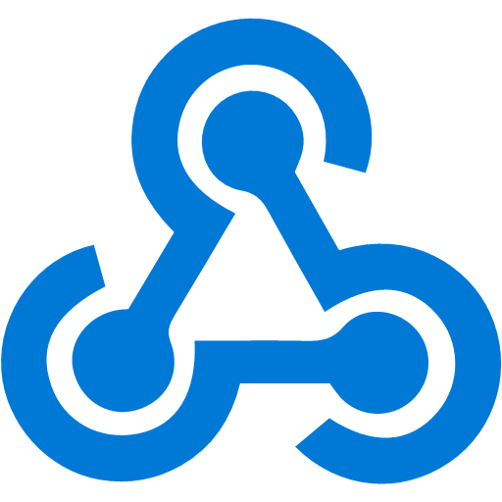




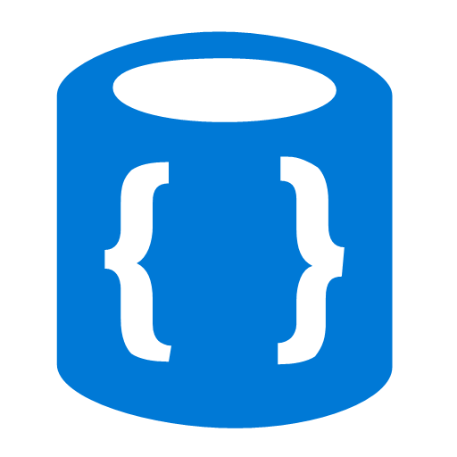


Azure Functions
Events
Code
Outputs
React to timers, HTTP, or events from your favorite Azure services, with more on the way
Author functions in C#, F#, Node.JS, Java, and more
Send results to an ever-growing collection of services

Slide 9

Sample scenarios for Functions
Web application backends
Mobile application backends
IoT-connected backends
Conversational bot processing
Real-time file processing
Real-time stream processing
Automation of scheduled tasks
Extending SaaS Applications

Slide 10



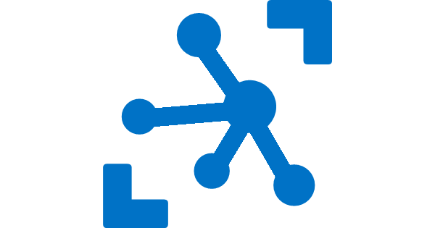
Your Environment
Consumption
Serverless
(Windows / Linux)
App Service Plan
Free, Basic, Standard, Premium
(Windows / Linux)
App Service Environment
Network Isolation
Azure Stack
On Premises
Azure Functions Runtime (preview)
Functions on your Server
Azure IoT Edge On Devices
Pay only for what you use! Metering is per execution and per GB Second.
All the advantages of Functions with the SLA and ‘always on’ features of an App Service Plan.
Your own dedicated cloud environment with network isolation for apps, higher scale, and the ability to connect securely to local vNets.
Leverage cloud innovations in on-premises infrastructure. Azure Stack brings the power of Azure to your own data centers.
Run on IoT Devices by deploying custom modules.
Run your Azure Functions on your local server (without the rest of Azure)

Slide 11
Your Language, Your IDE
Editor | Languages | Features | Platform
Azure Portal | C# / F# (script), Node.JS | Browser-based; host compiler; automatic dependencies mgmt | Any
Visual Studio Code | C# / F# (class library), Node.JS, Java | Lightweight; tons of extensions; local debugging | Any
Visual Studio | C# / F# (class library) | Remote debugging; cloud explorer; rich project types | Windows / Mac
IntelliJ | Java | Refactoring; Smart Completion; Maven integration | Any
Note taking file editor + Functions Core Tools | C# / F# (class library), Node.JS | Minimalism; traditional-style | Any

Slide 12
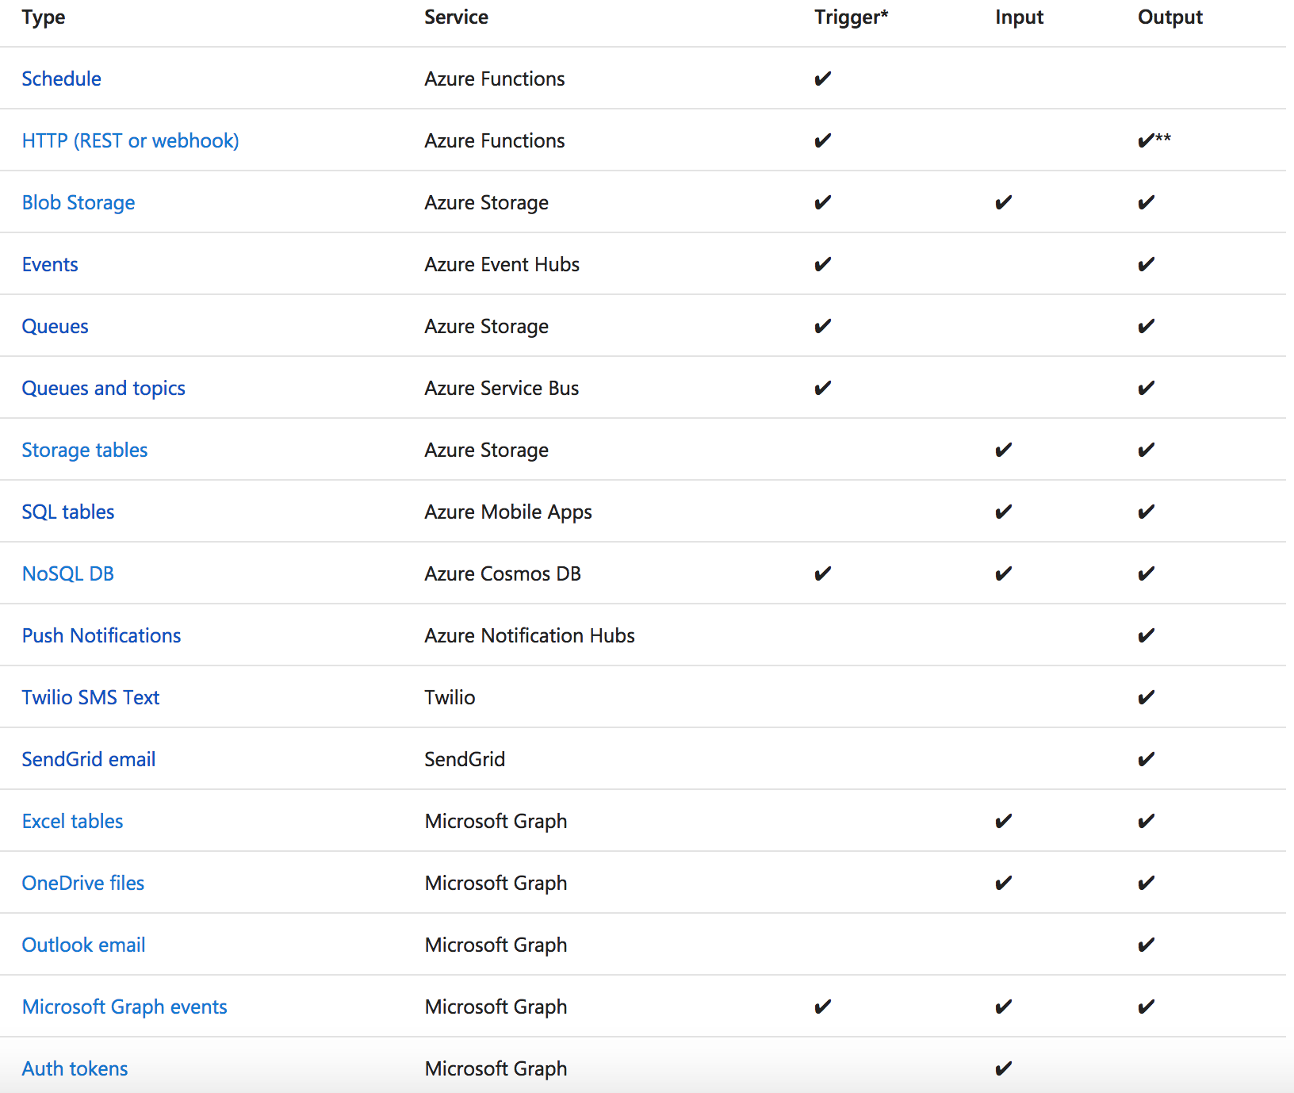
Functions triggers and bindings
Notes:
As I mentioned earlier, triggers and bindings are the things that facilitate easy communication with other services. This chart shows us the triggers and bindings currently supported. As we can see, there are a number of Azure services supported here…. for Storage, Database, Messaging, Notifications and so on. In addition to those, Functions also support generic Http triggers, which means you can easily write a piece of code that can be used to respond to REST requests or requests from any service that supports webhooks. This also provides a really fast and easy mechanism for building extensions to SaaS applications. We are fully committed to making this list grow and making more check-marks appear in that table.

Slide 13
Serverless Programming Model - Best Practices
Functions logic should be stateless (minimize state)
Functions should be idempotent
One Task per Function (“do one thing”)
Functions should finish as quickly as possible
Avoid Recursions
Concurrency Limitations and Rate Limits
Notes:
These best practices should not be a surprise to anyone
Let’s have a quick recap:
A function, as a compute unit, should not assume sate is maintain in between invocations – it is NOT. If you care for state, make sure you use a state store and pass enough context between function invocations.
Functions should be idempotent. All most ALL the documentation regarding triggers (event-source) for function are stating at least once delivery (queue, topics, streams…) therefore so should you
One task per function, make sure you optimize for scale and easier management
Serverless has a timelimit, currently 5 min, make sure you owner it
And with the time limit in mind, do try to avoid recursion and do not manipulate object in the functions event-source. That is if you have a blob trigger, try not to write back to the same blob (bucket) and have your function code make a determine if to process the object or not. It is a waste of money (first 100 msec cost you) and it is a recipe for disaster
Most of the worlds compute still runs on legacy systems and as more and more workloads moves to the cloud, we see the need to make sure we don’t overflow downstream systems.
That’s great, but not every system or workflow can conform to these expectations.
Serverless has unique advantages and challenges to consider. For example:
You can chunk work (microservices)
You can parallelize work (because we’re distributed and running on multiple VMs)
You need to let your client know if you’re going to take a while so they can come back and check – don’t leave them hanging!
So it takes some adaptation.
Unfortunately, all three of those things I mentioned can be difficult to wrangle:

Slide 14
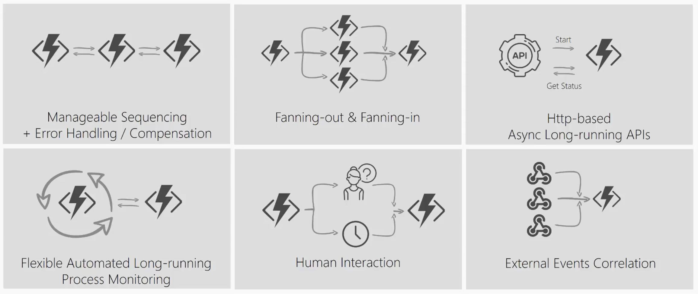
What’s still hard?
Notes:
Imagine a scenario where I have to take the output of a Function and use it as the input to call another Function. I’ll have to coordinate the chaining manually.
If I have to have a function that takes some sort of event and then parallelizes it into multiple Functions, I can still do that but how will I know when all Functions have finished executing so I can aggregate the results and move on.
What if I had to listen on multiple events and aggregate their outcome to determine which specific job or function to run in my application.
What if I wanted to do some kind of extended monitoring on an endpoint? For example, if I were to monitor the temperature of a remote machine and take action x if the temperature were lower than a certain threshold, else do y or run job y.
What if I have an API or endpoint that was running for a long time? I know Functions are short-lived but sometimes you guys put some serious load on them. Could there be a mechanism to provide status of the execution back to the client so they’re not left hanging?
And lastly, what if I wanted to get some sort of human interaction in there? For example, if I am to do some sort of 2FA in the middle of my function execution but also don’t want to wait forever because sometimes people take forever to reply especially when the texts are automated.
Today, I’m going to be talking about some of these problems – how you can approach them in regular FaaS? And how they can be simplified with the technology of Durable Functions.

Slide 15
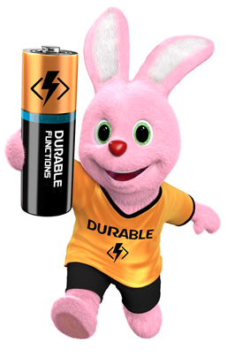
Introducing Durable Functions
Write long-running orchestrations as a single function while maintaining local state.
Simplify complex transactions and coordination (chaining, etc.) Easily call a Function from another Function, synchronously or asynchronously.
All of the above using code-only. No JSON schemas. No graphical designer.
Generally available (v1). Supports multiple languages (C#, JavaScript)
Notes:
Durable Functions is an advanced feature of Azure Functions. They provide the ability to write long running orchestrations using a single function while still being able to maintain a global state.
Durable highly simplifies some of the scenarios that we saw in the previous slides by making it easy to implement scenarios such as chaining, fan out / fan in , etc.
While still being able to use your beloved code constructs. You don’t have to conform to an JSON schemas or adopt any graphical workflow designers.
So let’s take a look at what it means to use Durable Functions ….. with some real world problems or patterns ->

Slide 16
Components
Starter
Function
Orchestrator Function
Activity Function
Activity Function
Activity Function
Starts orchestrations
Coordinates activities
Performs work
OrchestrationClient
OrchestrationContextTrigger
ActivityTrigger

Slide 17
What It Looks Like
Orchestrator Function
// calls functions in sequence
public static async Task<object> Run(DurableOrchestrationContext ctx)
{
try
{
var x = await ctx.CallFunctionAsync("F1");
var y = await ctx.CallFunctionAsync("F2", x);
return await ctx.CallFunctionAsync("F3", y);
}
catch (Exception)
{
// global error handling/compensation goes here
}
}
Activity Functions
Notes:
> So in Durable Functions, we introduce the concept of “an orchestrator" that will orchestrate or manage what happens between rest of the Functions.
> It is responsible for calling and receiving output from activity functions that you’re familiar with as regular functions. When an activity returns, it return value becomes part of the local state of the orchestrator function so you’re able to work with it as any other variable in that block of code.
> CallFunctionAsync uses queues under the covers, thus they can be scaled out to multiple VMs.
The other thing is that if I want to have exceptions in my code, say something goes wrong in a particular function, I can do that. We’re all familiar with the syntax and now we can do it in a distributed way.
Mention rewind feature to talk about in new developments

Slide 18
Demo 1
Function Chaining + Local Development
Notes:
> Function Chaining
Objective:
Intro to orchestrator and activity functions
Local Development
JavaScript Support
Azure Functions supports debugging function code directly, and that same support carries forward to Durable Functions, whether running in Azure or locally. However, there are a few behaviors to be aware of when debugging:
Replay: Orchestrator functions regularly replay when new inputs are received. This means a single logical execution of an orchestrator function can result in hitting the same breakpoint multiple times, especially if it is set early in the function code.
Await: Whenever an await is encountered, it yields control back to the Durable Task Framework dispatcher. If this is the first time a particular await has been encountered, the associated task is never resumed. Because the task never resumes, stepping over the await (F10 in Visual Studio) is not actually possible. Stepping over only works when a task is being replayed.
Messaging timeouts: Durable Functions internally uses queue messages to drive execution of both orchestrator functions and activity functions. In a multi-VM environment, breaking into the debugging for extended periods of time could cause another VM to pick up the message, resulting in duplicate execution. This behavior exists for regular queue-trigger functions as well, but is important to point out in this context since the queues are an implementation detail.

Slide 19
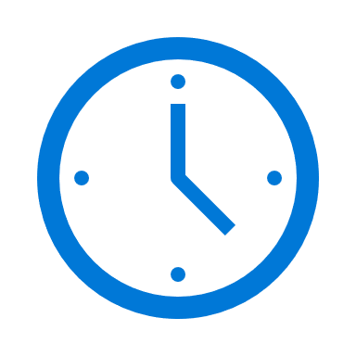

var outputs = new List<string>();
outputs.Add(await context.CallActivityAsync<string>("SayHello", “Seattle"));
return outputs;
History Table
Orchestrator Function
Orchestrator Function
Activity Function
Orchestrator Started
Activity Function
Execution Started
Task Scheduled, SayHello, “Seattle”
Orchestrator Completed
[“Hello Seattle!”]
“Hello Seattle!”
“Hello Seattle!”
Task Completed, “Hello Seattle!”
?
Orchestrator Started
Execution Completed, ["Hello Seattle!"]
Orchestrator Completed
Execution History
Notes:
Grasping how orchestrators use execution history to replay and rebuild their local state is key to understanding how Durable Functions works, so let’s walk through the execution of a simple orchestrator function.
The light blue box at the top of the slide is the orchestrator’s code.
“SayHello” our activity function, which returns “Hello” and whatever input you give it.
Our execution history is currently empty. As we start to record events, they’ll show up here. (Indicate area.)
1. A request is made to the orchestrator function.
2. The orchestrator starts and begins executing until it’s asked to await some async work. In this case, we want to call an activity function.
3. The orchestrator checks the execution history for a record of the activity function.
4. There’s no record of the activity function being called or completed, so the orchestrator schedules that work.
5. While the orchestrator waits on work to complete, it shuts down.
5. The scheduled activity function runs.
6. A record of this is added to the execution history. In this case we produced output, so that’s stored.
7. Now the orchestrator has more work to do. It restarts and executes its code **from the beginning** to build up its local state.
8. As before, the orchestrator executes until it reaches an await.
9. The orchestrator checks the execution history. This time there’s a record of the async work being done.
10. The activity function’s stored output is passed back to the orchestrator. In this case, the value is added to a list of strings.
11. The orchestrator continues executing. In a more complex orchestrator with multiple await calls, the checkpoint, schedule and replay steps would repeat for each one. This orchestrator runs to completion and returns its output.
12. And we’re done!
- How does the framework know to wake up

Slide 20
Orchestrator Constraints
Orchestrator code must be deterministic
Never use random numbers, DateTime.UtcNow, Guid.NewGuid(), etc.
Use DurableOrchestrationContext.CurrentUtcDateTime
Never do I/O directly in the orchestrator
Do I/O in activity functions
Don’t write infinite loops
Use DurableOrchestrationContext.ContinueAsNew()

Slide 21
Demo 2
Fan-Out/Fan-In + Scaling + Diagnostics
Notes:
> Fan-out / Fan -in
Objective:
Azure hosted demo
Triggers and Bindings
Live monitoring
Show Live Monitoring and Scale Out
Show Diagnostics Queries:
historical tracking data for a single instance
let targetInstanceId = “[functionid]"; let start = datetime(2018-03-25T09:20:00); traces | where timestamp > start and timestamp < start + 30m | where customDimensions.Category == "Host.Triggers.DurableTask" | extend functionName = customDimensions["prop__functionName"] | extend instanceId = customDimensions["prop__instanceId"] | extend state = customDimensions["prop__state"] | extend isReplay = tobool(tolower(customDimensions["prop__isReplay"])) | extend sequenceNumber = tolong(customDimensions["prop__sequenceNumber"]) | where isReplay != true | where instanceId == targetInstanceId | sort by timestamp asc, sequenceNumber asc | project timestamp, functionName, state, instanceId, sequenceNumber, appName = cloud_RoleName
Instance summary query
let start = datetime(2017-09-30T04:30:00); traces | where timestamp > start and timestamp < start + 1h | where customDimensions.Category == "Host.Triggers.DurableTask" | extend functionName = tostring(customDimensions["prop__functionName"]) | extend instanceId = tostring(customDimensions["prop__instanceId"]) | extend state = tostring(customDimensions["prop__state"]) | extend isReplay = tobool(tolower(customDimensions["prop__isReplay"])) | extend output = tostring(customDimensions["prop__output"]) | where isReplay != true | summarize arg_max(timestamp, *) by instanceId | project timestamp, instanceId, functionName, state, output, appName = cloud_RoleName | order by timestamp asc
Replay behavior: context.IsReplaying

Slide 22
var outputs = new List<string>();
outputs.Add(await context.CallActivityAsync<string>("SayHello", “Seattle"));
return outputs;
Starter
Control Queue
Orchestrator
SayHello
Work-Item Queue
Notes:
Orchestrator and Activity Functions are both triggered by internal queues in the function app’s default storage account.
Work-Item Queue: Used to trigger stateless activity functions. One work-item queue per task hub. When a DF app scales to multiple VMs, the VMs compete to acquire work from the queue.
Control Queue: Used to trigger the stateful orchestrator functions. Because orchestrator functions are stateful singletons, it’s not possible to use a competing consumer model to distribute load across VMs. Instead, orchestrator messages are load-balanced across multiple control queues.

Slide 23

Storage Backend & Scaling
Worker
Worker
Control Queue(s)
Worker
Work Item Queue
Triggers orchestrator
function execution
Triggers activity function execution
Worker
Worker
Stateful/Partitioned
History Table
Stateless
Notes:
History Table: Contains history events for all orchestration instances. Partition key derived from instance ID of orchestration – we use an internal hash function of the instance ID, which are random GUIDs by default, for optimal distribution across partitions. (Take this into account if you’re giving custom instance IDs to your orchestrators.)
Orchestrator and Activity Functions are both triggered by internal queues in the function app’s default storage account.
Work-Item Queue: Used to trigger stateless activity functions. One work-item queue per task hub. When a DF app scales to multiple VMs, the VMs compete to acquire work from the queue.
Control Queue: Used to trigger the stateful orchestrator functions. Because orchestrator functions are stateful singletons, it’s not possible to use a competing consumer model to distribute load across VMs. Instead, orchestrator messages are load-balanced across multiple control queues.
So what does this mean?
If you’re running on a consumption plan, auto-scale is supported via the scale controller like a regular Functions app.
Activity functions scale out automatically.
Orchestrator functions are partitioned. The number of control queues can be configured in your host.json as of yesterday.
Each VM takes a lock on a control queue. This ensures an orchestration instance only runs on one VM at a time.
Orchestrator function handling scale-out is capped at your number of control queues. The intent is that orchestrator functions are lightweight and don’t require a lot of compute power.
Activity functions scale limitlessly.
Task Hub partitions: default 4, set from 1 to 16 – you can scale up past the number of partitions you set, but that’s the cap on control queues
Threads: Orchestrator functions are executed on a single thread to ensure deterministic behavior. Therefore, be mindful and avoid blocking operations like I/O (which you shouldn’t be using in an orchestrator anyways), spinning, or so on.
Move multi-threaded work into activity functions.
Re: threads in activity functions: . Yes, you can instantiate threads. They're all still tracked as normal CPU cycles since they all originated from the same process.
There are some numerical sandbox limits, detailed in the project kudu wiki.
We recently added a configurable Host Health Monitor that will watch when you get close to the limits:

Slide 24
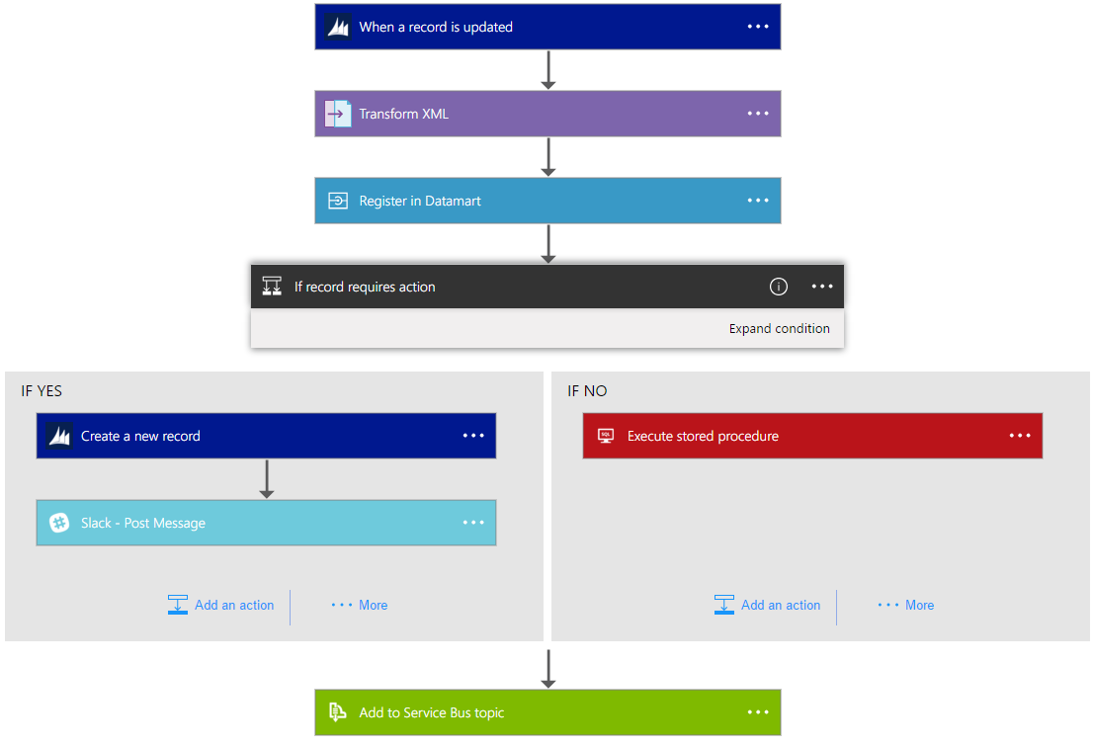
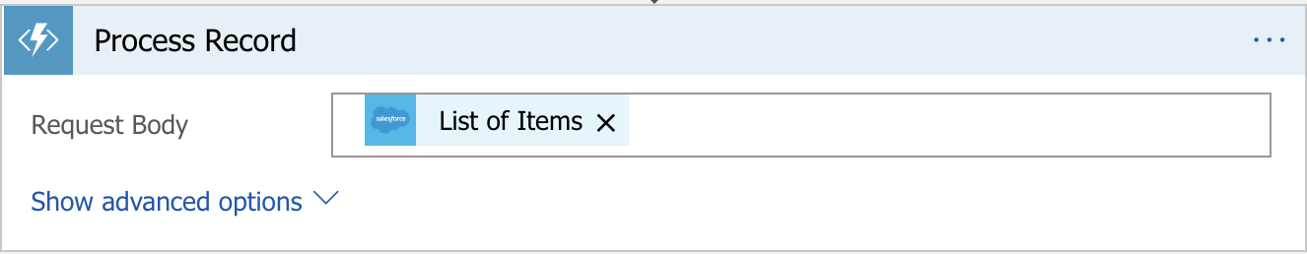
Logic Apps
Notes:
So that’s how Durable Functions let you build and coordinate complex workflows using a single orchestrator function, extending to everything that’s possible to do with code.
But you might tell me – this is great but I’m on the other side of the house that like to see graphical representations of my workflows. Well, I have good news for you – let me introduce you to the Functions integration with Logic Apps. For those of you not familiar, Logic Apps is a workflow management service in Azure. It provides you with the ability to build flow from as simple as when a new items is added to my queue, run sentiment analysis on it to more complex workflows. In the neat visual designer that we have for logic apps, you can go ahead and add triggers and actions that correspond to various SaaS services. And the cool thing about Logic Apps is that you can add your Functions at various steps within the workflow – as basic actions, conditions, switch loops, etc. – all within the graphical designer.

Slide 25

Durable Functions vs Logic Apps
Both allow implementing advanced workflow patterns.
C#, F# and JavaScript | Visual Designer
<20 Bindings | 200+ Connectors
Portable runtime | Runs only on Azure
Monitoring based on App Insights and APIs | Rich monitoring and management tools
Serverless, dedicated and isolated | Serverless only
Notes:
At the end of the day, both durable functions and logic apps have their benefits. From speaking with several customers, we’ve realized that which one you choose is simply a matter of individual preference.
Logic Apps is a big product itself with several features of its own so I wont dive into too much detail about that here but feel free to stop by our booth to see some demoes and get more information.
Logic Apps can run Durable Functions! You can hook them into your Logic Apps workflows.

Slide 26
New and Upcoming Features
Functions v2 GA
JavaScript support (v2 only)
Rewind orchestrations
Functions CLI integration
Performance and reliability improvements

Slide 27
More Information
Documentation: https://aka.ms/durablefunctions
GitHub:
https://github.com/Azure/azure-functions-durable-extension
https://github.com/Azure/durabletask/tree/azure-functions
Twitter:
@AzureFunctions
@cgillum
@kashimizMSFT
@ling_toh

Slide 28
Thank you!

